Slide 1
Cassandra
By Altotech

Slide 2

What is Cassandra?
The Apache Cassandra database is the right choice when you need scalability and high availability without compromising performance.

Slide 3



Cassandra is used by
And many more...

Slide 4
Cassandra claims that
PROVEN
Cassandra is in use at Constant Contact, CERN, Comcast, eBay, GitHub, GoDaddy, Hulu, Instagram, Intuit, Netflix, Reddit, The Weather Channel, and over 1500 more companies that have large, active data sets.
FAULT TOLERANT
Data is automatically replicated to multiple nodes for fault-tolerance. Replication across multiple data centers is supported. Failed nodes can be replaced with no downtime.

Slide 5
Cassandra claims that
PERFORMANT
Cassandra consistently outperforms popular NoSQL alternatives in benchmarks and real applications, primarily because of fundamental architectural choices.
DECENTRALIZED
There are no single points of failure. There are no network bottlenecks. Every node in the cluster is identical.

Slide 6
Cassandra claims that
SCALABLE
Some of the largest production deployments include Apple's, with over 75,000 nodes storing over 10 PB of data, Netflix (2,500 nodes, 420 TB, over 1 trillion requests per day), Chinese search engine Easou (270 nodes, 300 TB, over 800 million requests per day), and eBay (over 100 nodes, 250 TB).
DURABLE
Cassandra is suitable for applications that can't afford to lose data, even when an entire data center goes down.

Slide 7
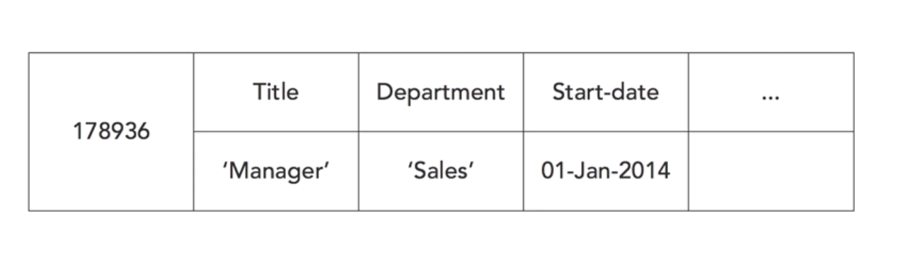
Cassandra row of data

Slide 8
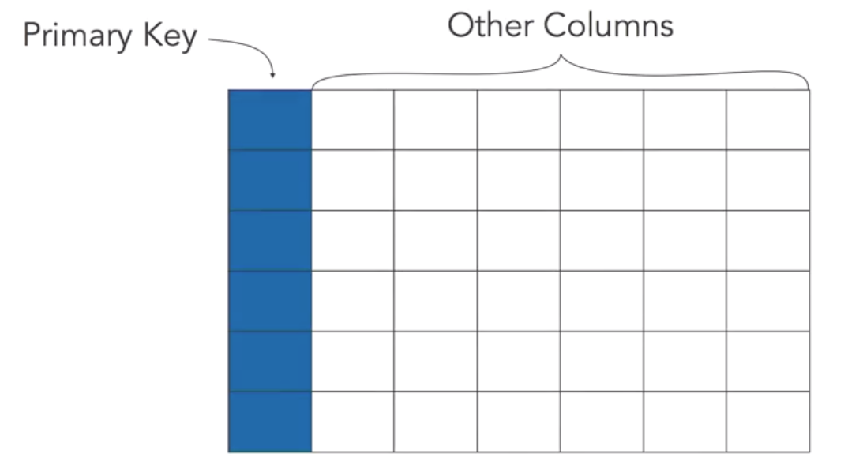
Primary key
Cassandra tables have primary keys, which uniquely identify rows in a table. Primary keys are used to access data in Cassandra. Primary keys are not enough to find rows in Cassandra, because Cassandra is designed to run on a cluster of servers.

Slide 9
Partition Key
Clustering Column
A partition key is used to determine which node in the cluster to store a row in.
A clustering column defines the order in which rows are stored.

Slide 10
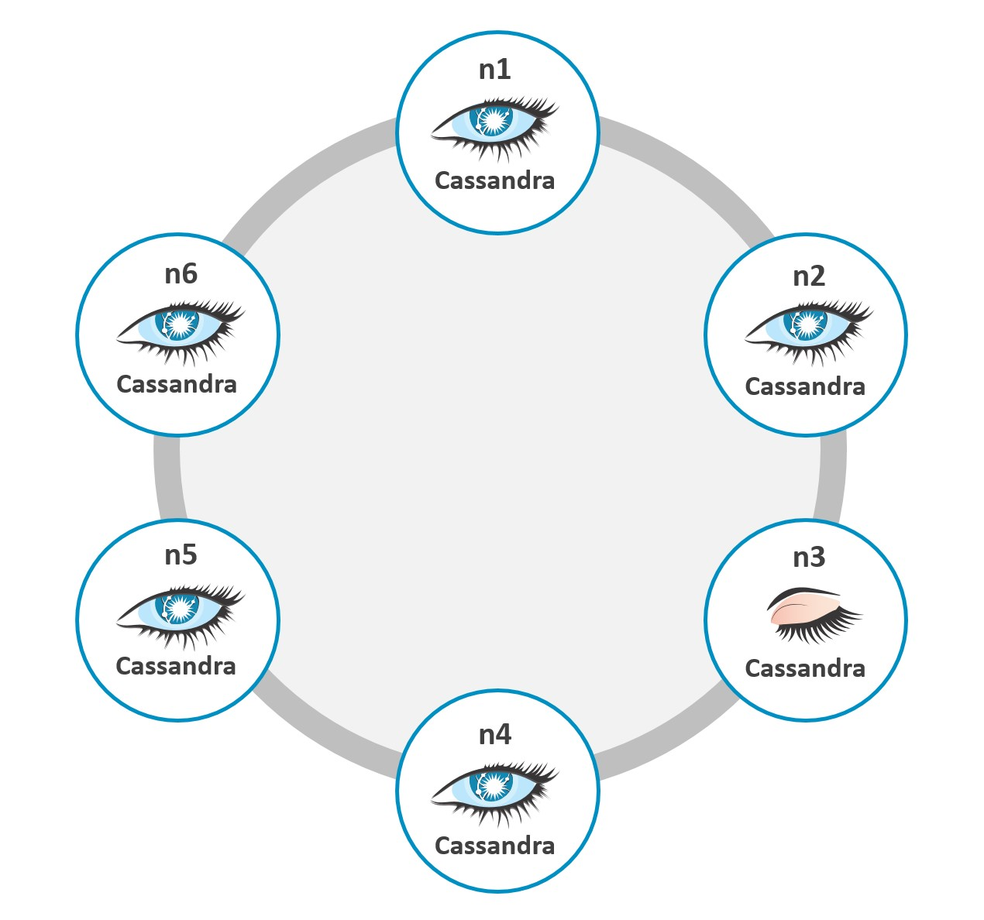
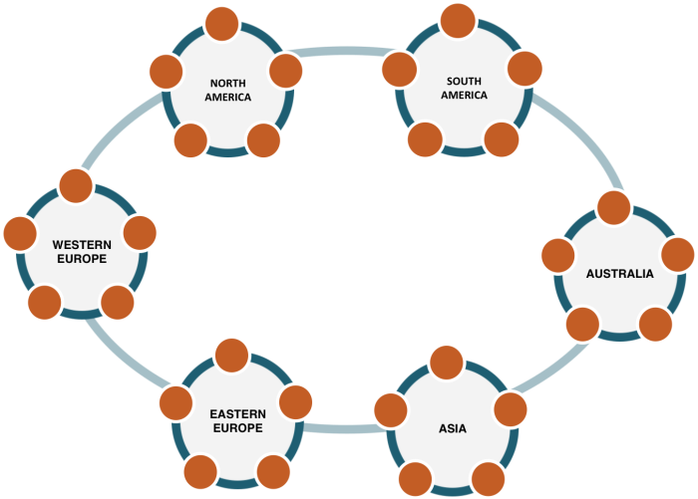
Cassandra cluster
There is no single server in a highly-available Cassandra database.

Slide 11
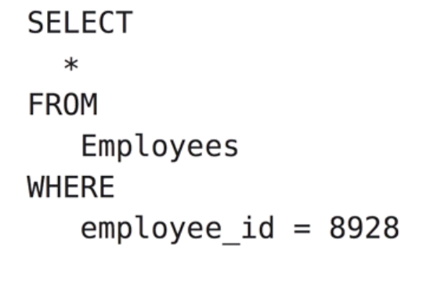
Cassandra Query Language (CQL)
It is similar to SQL, but has more restrictions.

Slide 12
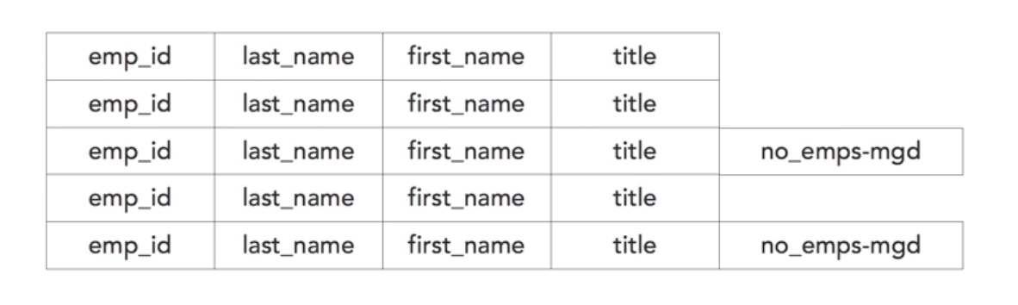
No fixed Schema

Slide 13
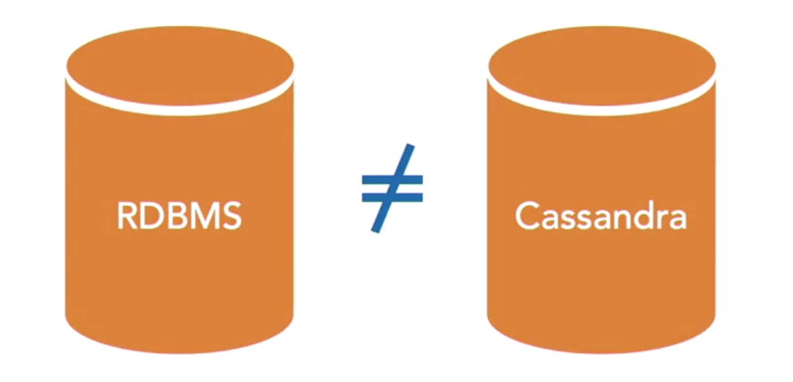
RDBMS and Cassandra are different.

Slide 14
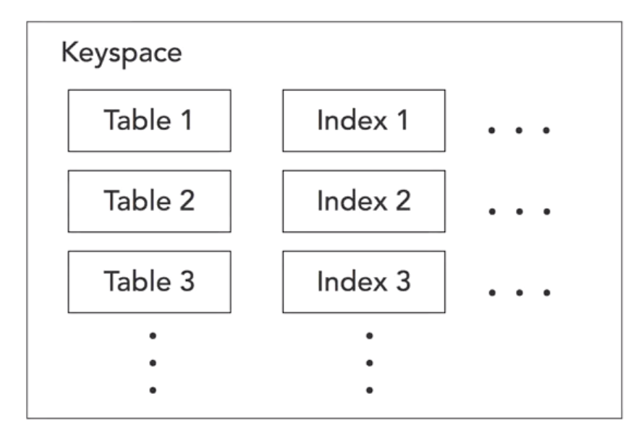
Keyspace
Keyspaces are logical containers for tables, indexes, and other data structures. Now in addition to providing a namespace for organizing data, the keyspace has attributes that control some important features of Cassandra.

Slide 15
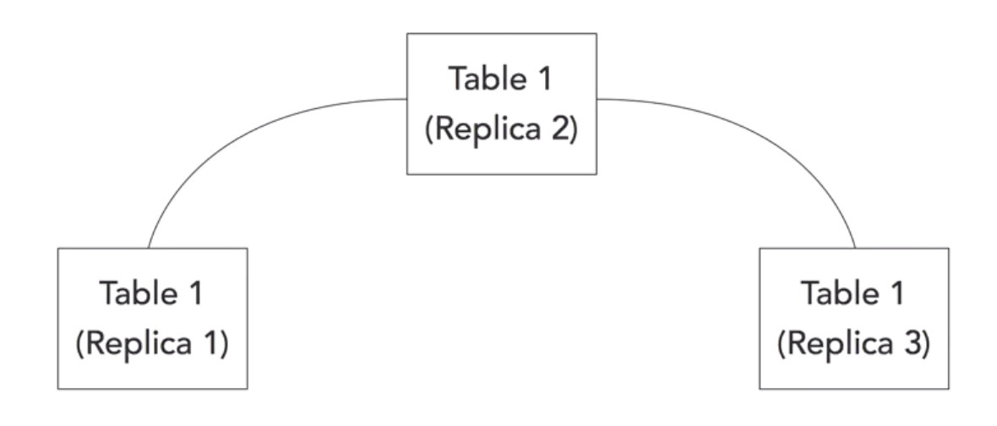
Replica
If a node fails, the data on the failed node, can still be accessed from one of its replicas.

Slide 16
Replication Strategies
There are two kinds of replication strategies.
The simple replication strategy is used to set a number of replicas when all nodes will be in a single data center.
The network topology strategy, is used to set a number of replicas when nodes will be distributed in multiple data centers. In both cases, the replica strategy takes a number of replicas as a paramater.

Slide 17
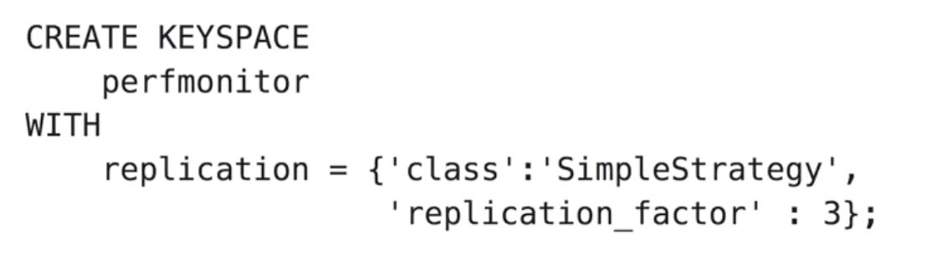
Keyspace Definition Example
This command has the CREATE KEYSPACE phrase, followed by the name of the KEYSPACE, followed by the keyword WITH, and then a replication specification, which in this case includes two attributes, the class, which is SimpleStrategy, and then the replication_factor, so we have 3 replicas.

Slide 18
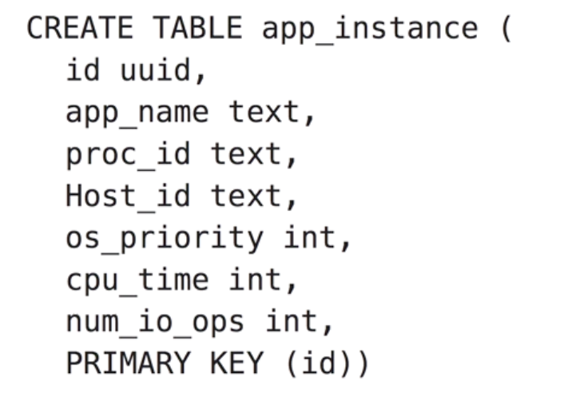
Table Definition Example
CREATE TABLE takes a list of attribute or column names, followed by a data type, such as text and int. It also takes a primary key clause to define which columns to use as the primary key.

Slide 19
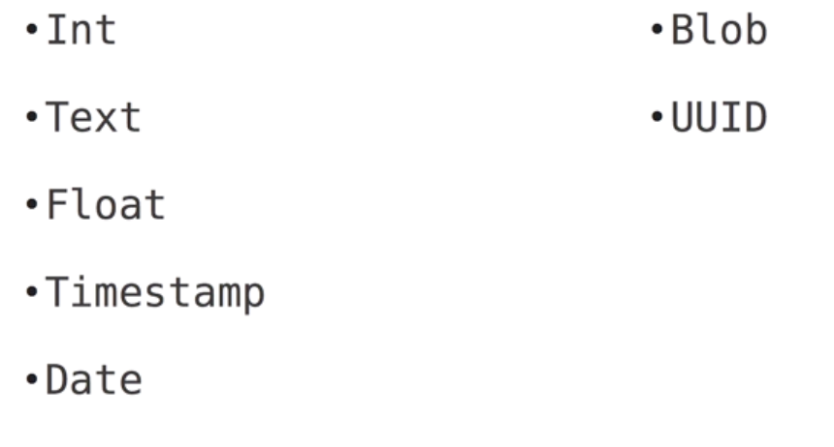
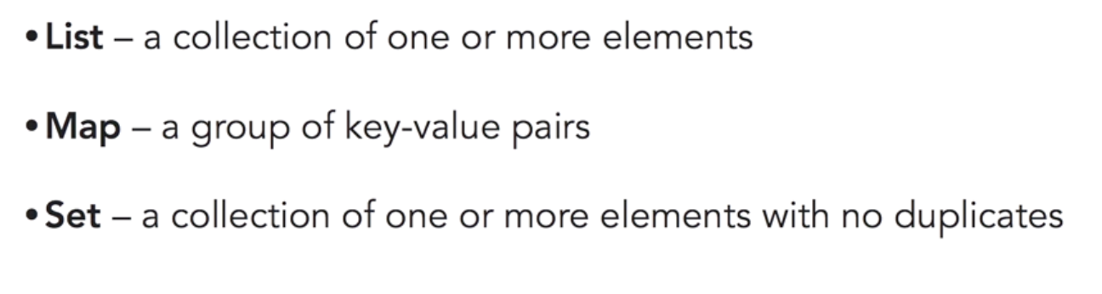
Data types
Basic Data types
Collection data types

Slide 20
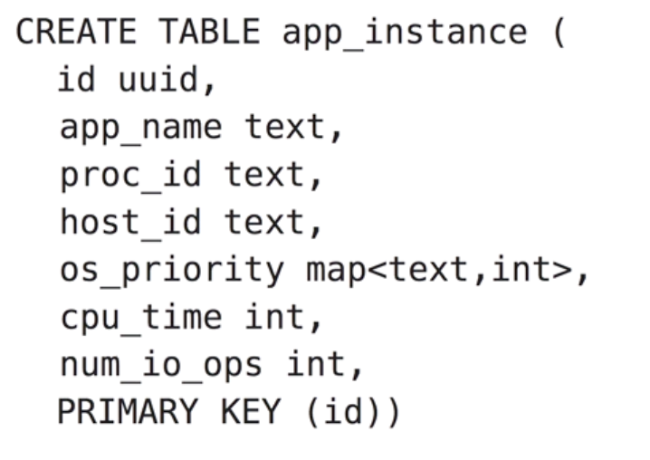
Table with Collection Example

Slide 21
PK, Partitions and Secondary indexes

Slide 22
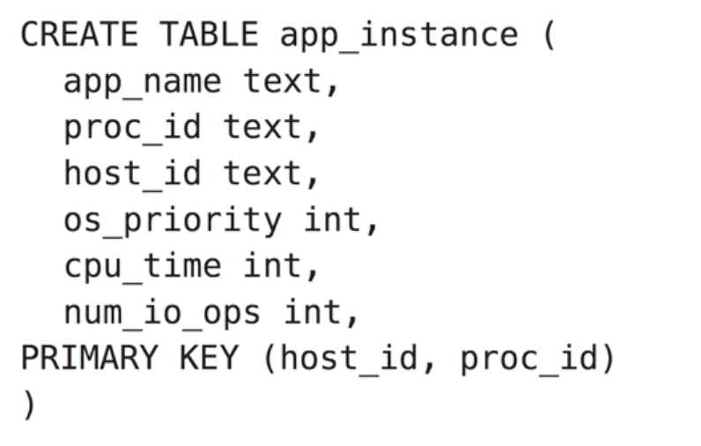
Partition key and Clustering key
This is because the first attribute specified in the primary key list is used as the partition key, which determines which node the row is stored on. The rest of the primary key is used as the clustering key, which determines how data is ordered on the disk.
We need to choose our primary keys carefully because they are used to retrieve data using select statements

Slide 23
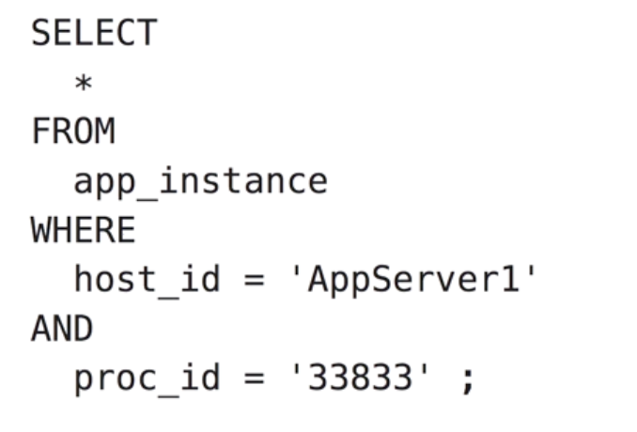
Selection Rows
This a valid query because we're specifying the full primary key. We specify SELECT star FROM our table app instance, WHERE, and then specify the host ID to be equal to AppServer1, and the process ID to be equal to 33833.

Slide 24
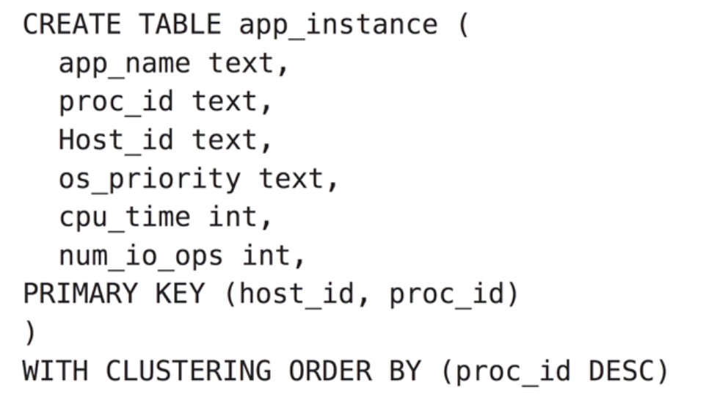
‘CLUSTERING ORDER BY’ clause
Cassandra gives us the option to change the default sort order of rows on the disk, but we have to do this when we create tables.

Slide 25
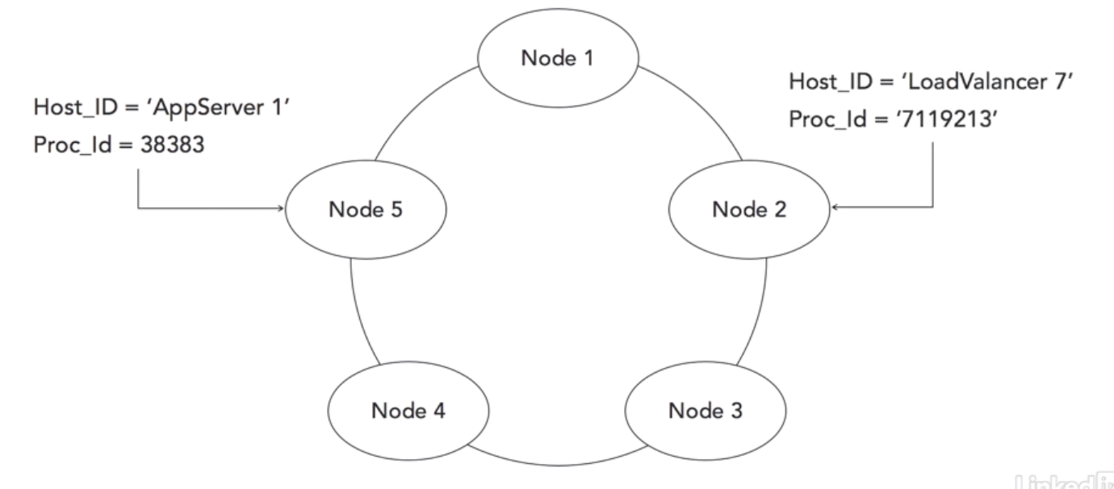
Hashing to node

Slide 26
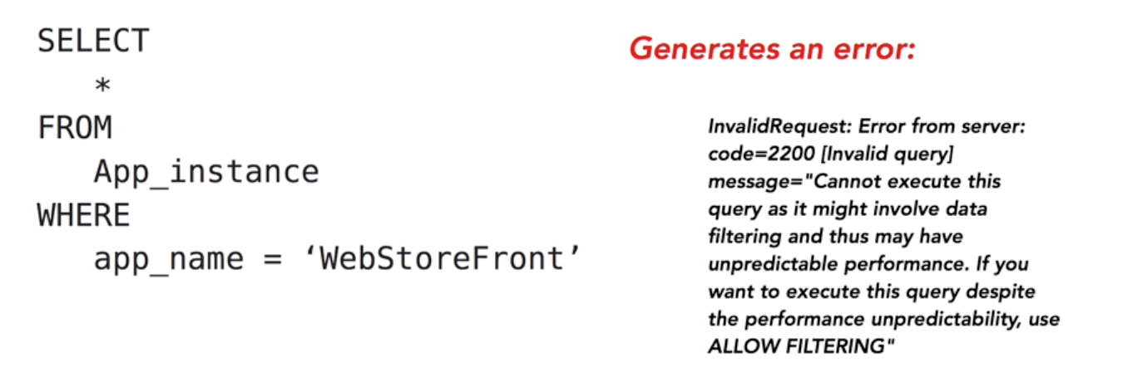
Arbitrary Filtering
Notes:
Sometimes, however, we want to look up by other values. So, for example, if we tried to run this query, SELECT star FROM App_instance, WHERE app_name equals WebStoreFront, we'll actually get an error message. As the error indicates, Cassandra cannot execute this query because it will involve filtering, or scanning through all of the rows, and that can have unpredictable performance implications. Now, if you really want to do this, you can add another clause called ALLOW FILTERING to your query.
But again, that may lead to unpredictable results. Now, Cassandra could spend a lot of time and CPU resources scanning large tables with a query like that.

Slide 27
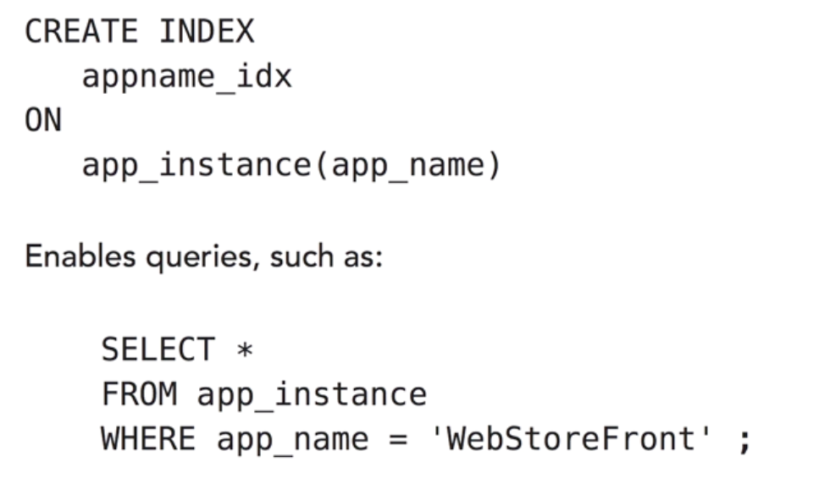
Indexes
We can help Cassandra filter data by using a secondary index. We can create an index using the following command. CREATE INDEX, and then specify an index name, and then specify ON, and then the table name, followed by the column name that we want to use for the index.

Slide 28
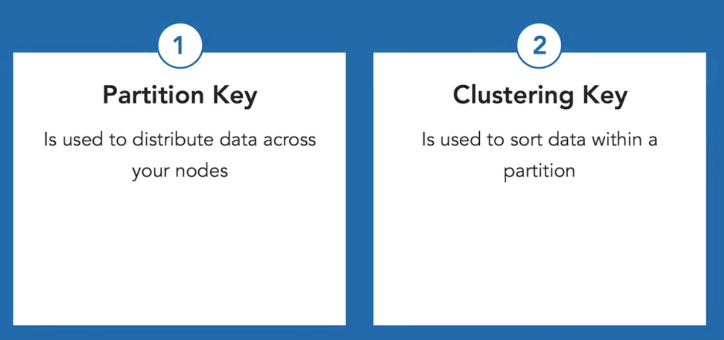
Wrap up

Slide 29
Cassandra Cluster

Slide 30
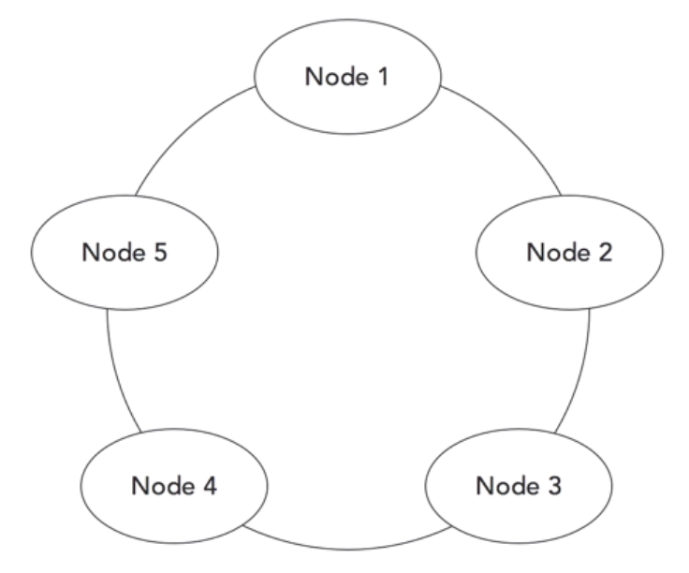
No master, No slaves
All nodes perform the same kinds of operations and can communicate with other nodes. There's no distinction between master and worker nodes in Cassandra. All nodes run the same services.

Slide 31
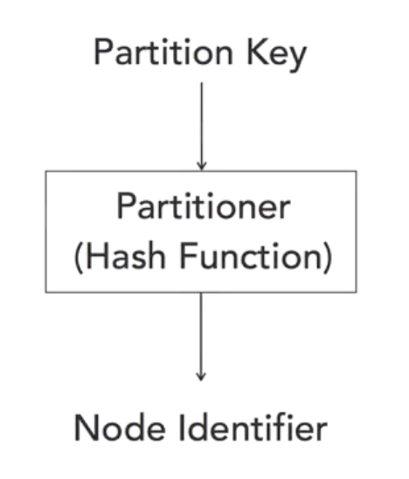
Hashing on Partition Key

Slide 32
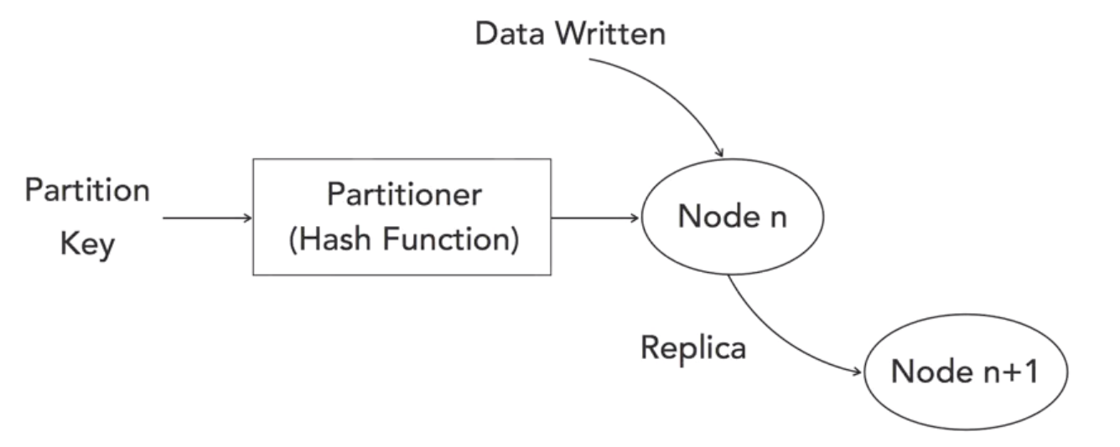
Replicating after write

Slide 33
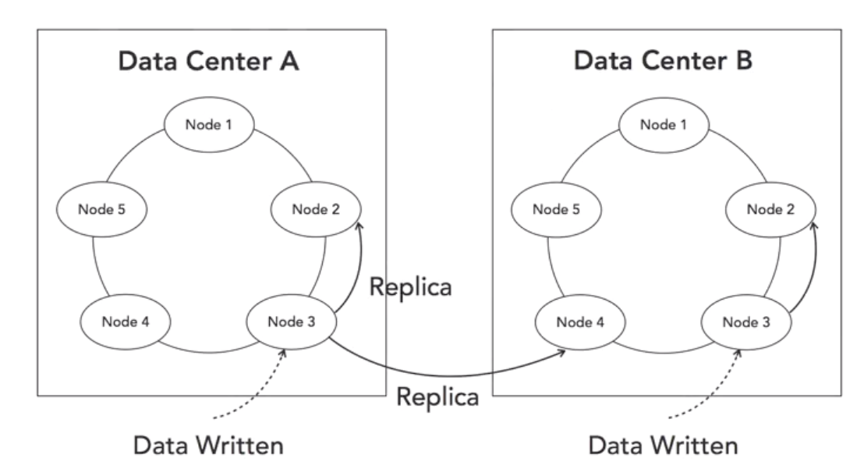
Replicating across cluster

Slide 34
Designing Cassandra Tables

Slide 35
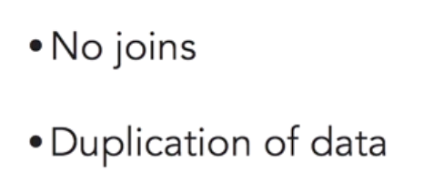
Cassandra != RDBMS
Cassandra is optimized for fast writes and fast reads over very large volumes of data. To achieve these levels of performance, Cassandra does things differently than relational databases. Joins can be time and resource-consuming operations. Cassandra avoids those by duplicating data in rows of a table.

Slide 36
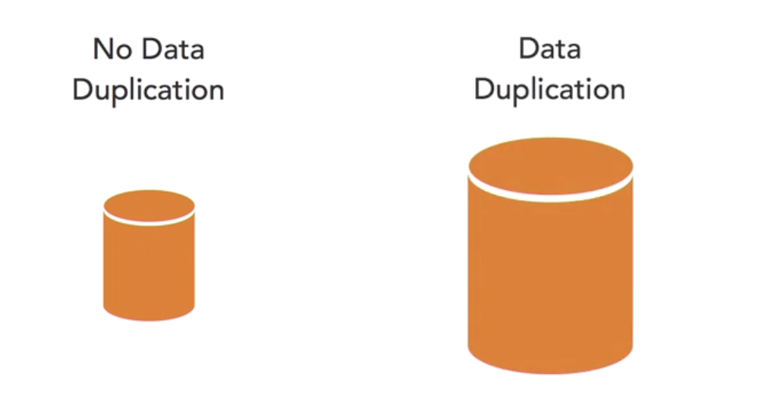
Trade off: Data size for speed

Slide 37
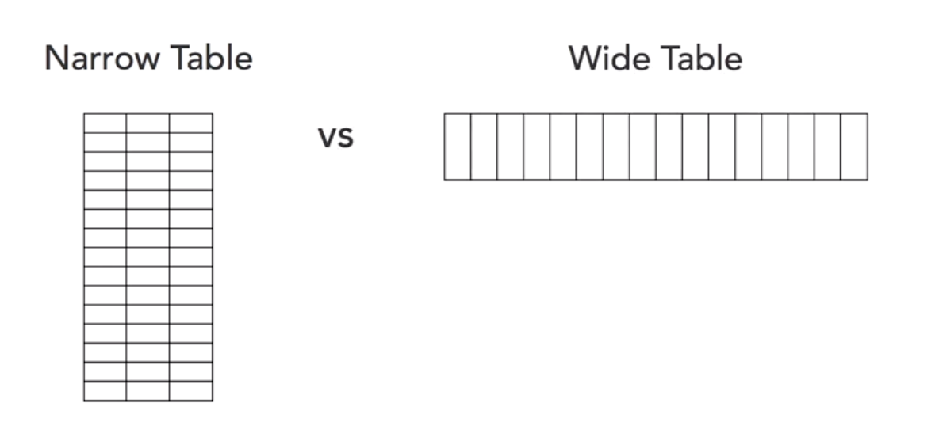
Narrow Table vs Wide Table

Slide 38
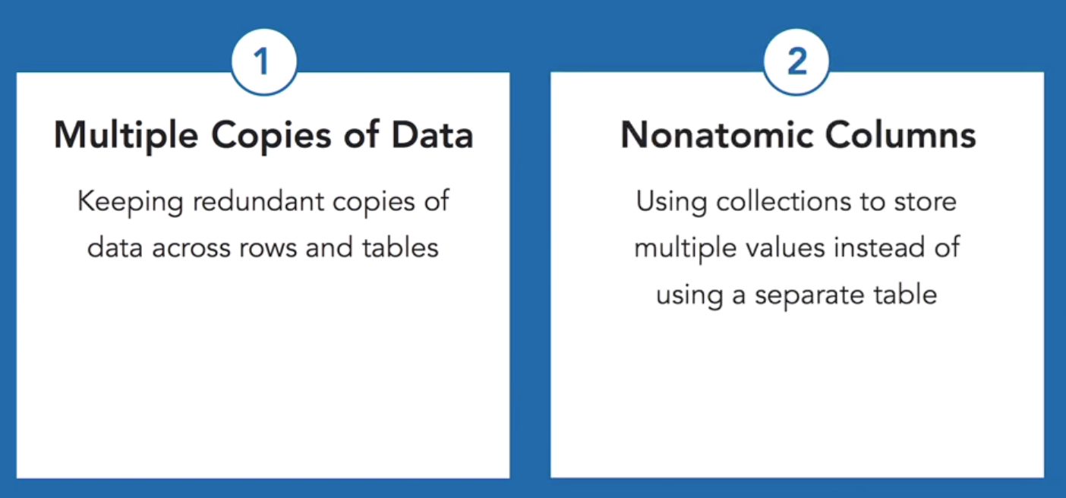
Denormalizing: Joining or Sorting

Slide 39
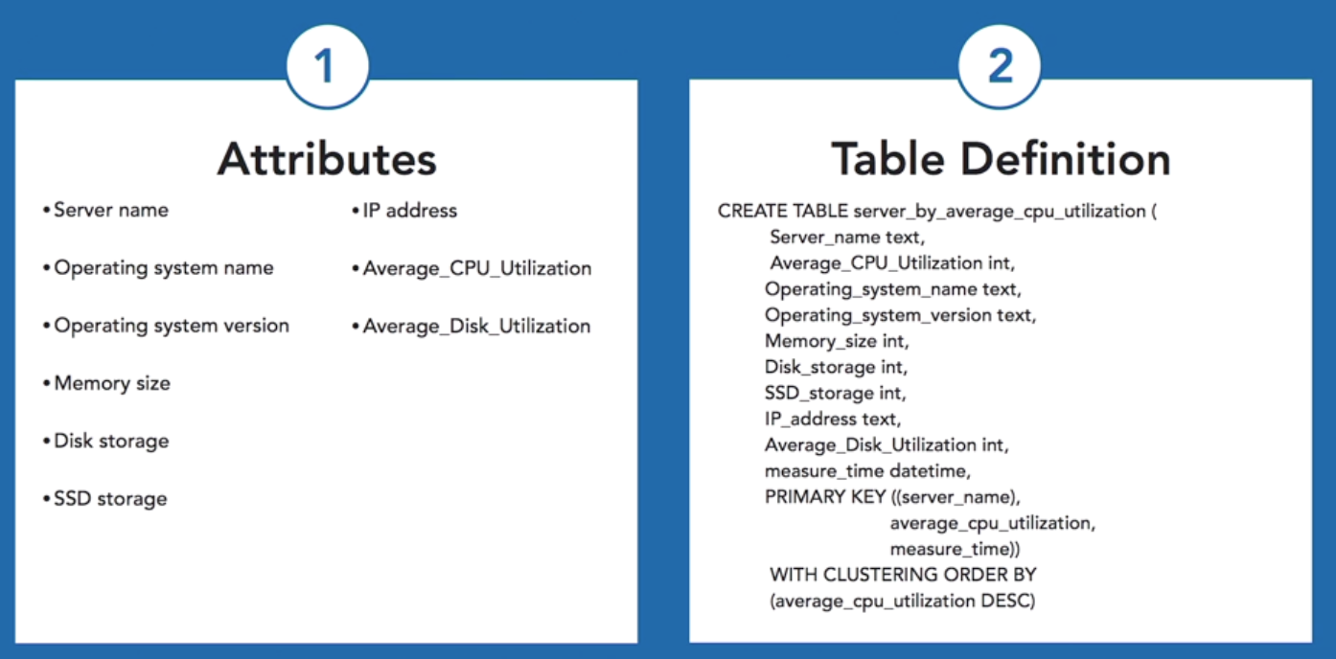

Slide 40
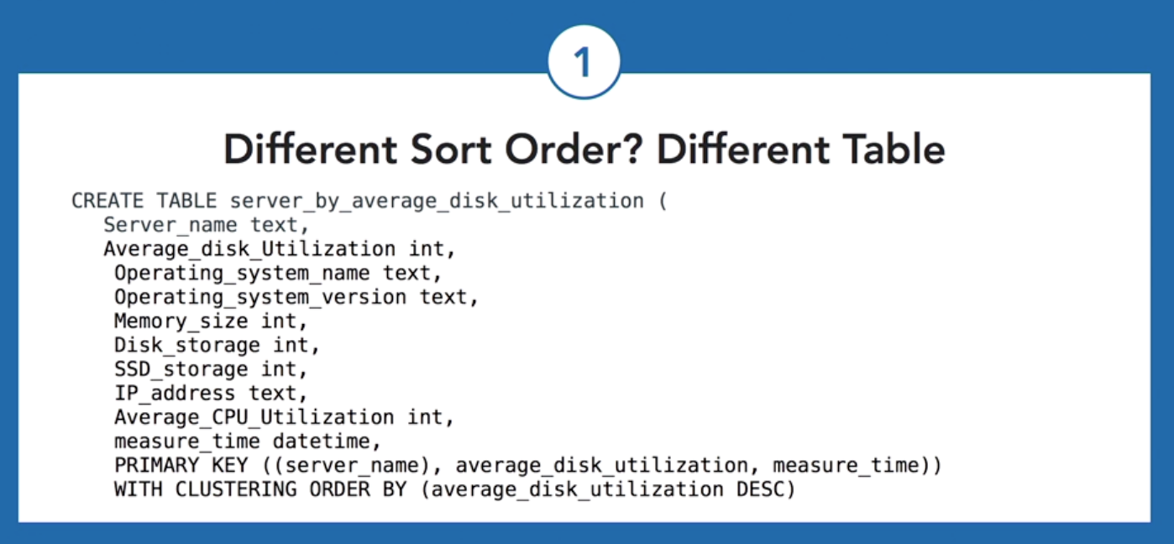
Notes:
Now imagine we need to answer another query that requires the same data but in a different order.

Slide 41
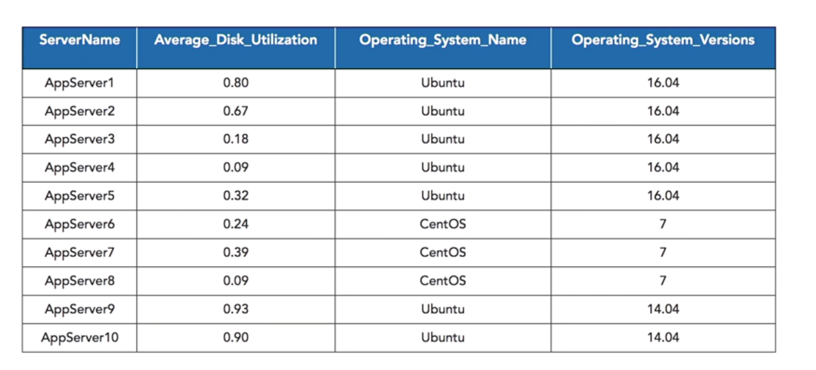
Duplicating avoid Joins

Slide 42
Best Practices

Slide 43
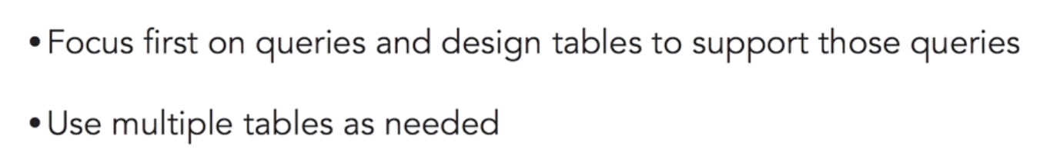
Model Based on Queries

Slide 44
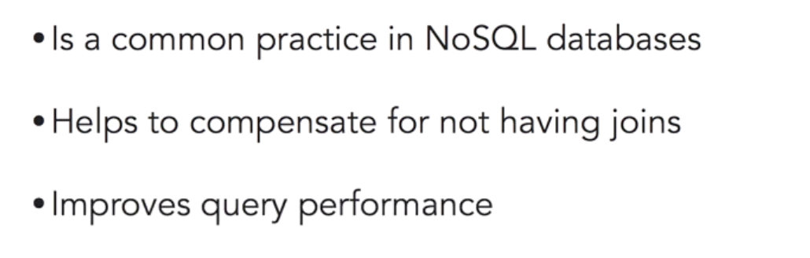
Denormalize

Slide 45
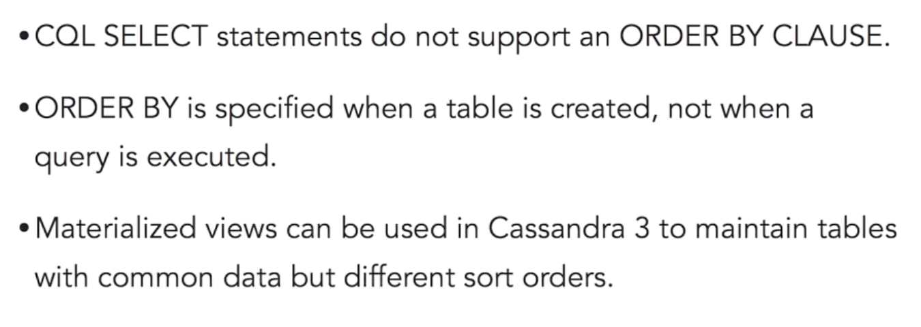
Plan for Sort Order

Slide 46
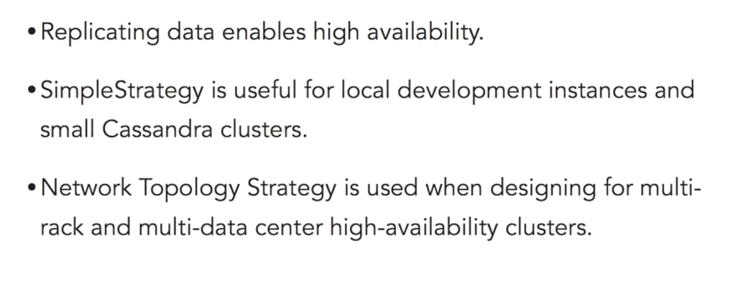
Understand Replication Strategies

Slide 47
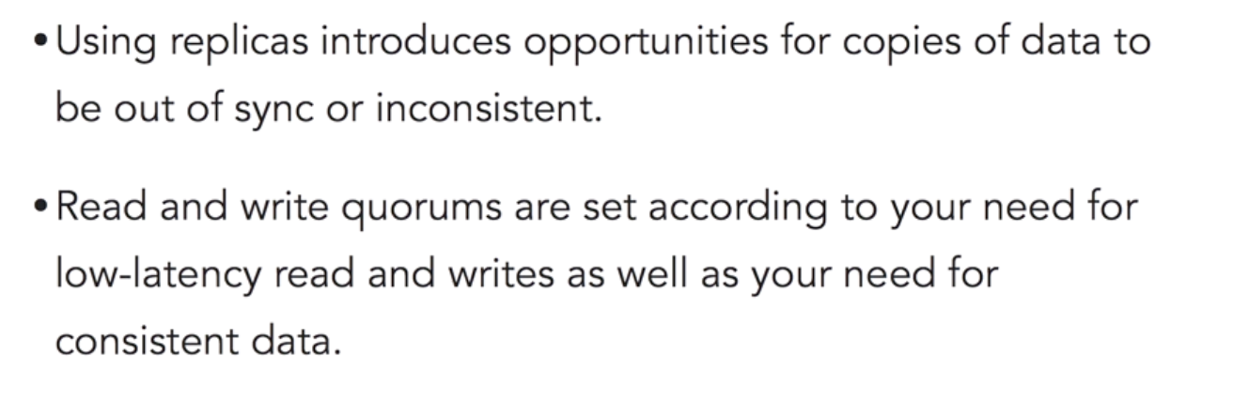
Understand Eventual Consistency

